Slide 1
QUINE-MC’CLUSKY’S
SIMPLIFICATION METHOD

Slide 2
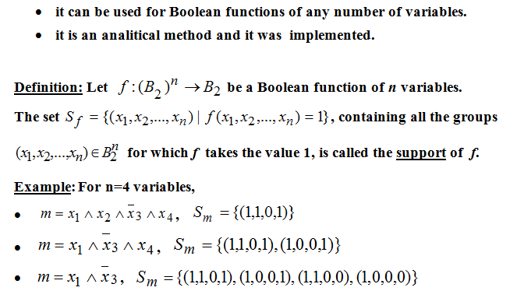
QUINE’S METHOD

Slide 3
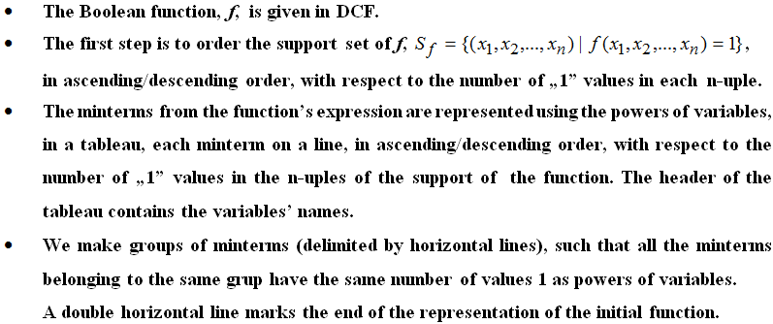
QUINE’S METHOD –DESCRIPTION (I)

Slide 4
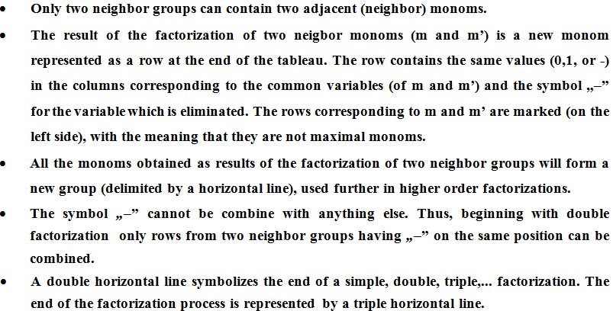
QUINE’S METHOD –DESCRIPTION (II)

Slide 5
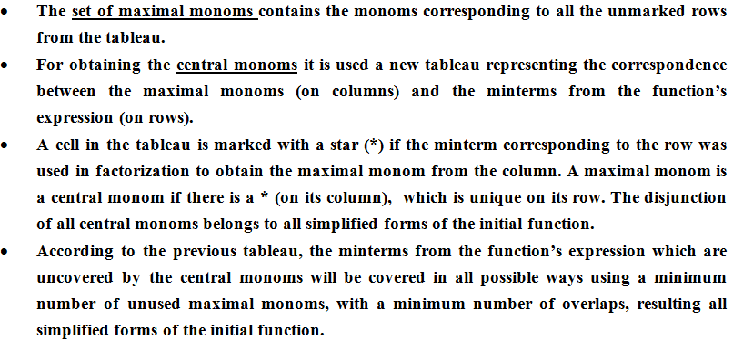
QUINE’S METHOD –DESCRIPTION (III)

Slide 6
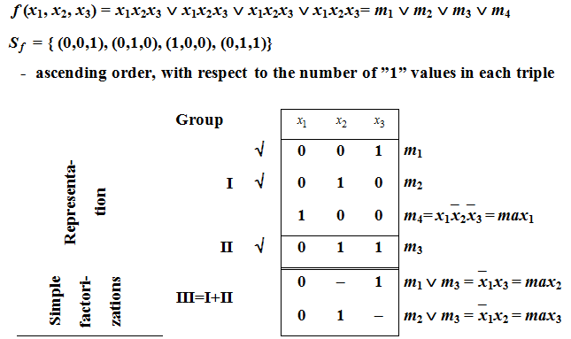
EXAMPLE 1. SIMPLIFY THE BOOLEAN FUNCTION

Slide 7
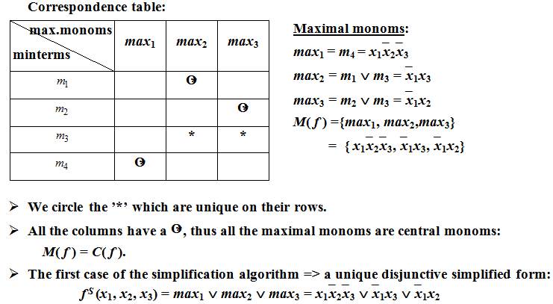
EXAMPLE 1 (CONTD.)

Slide 8
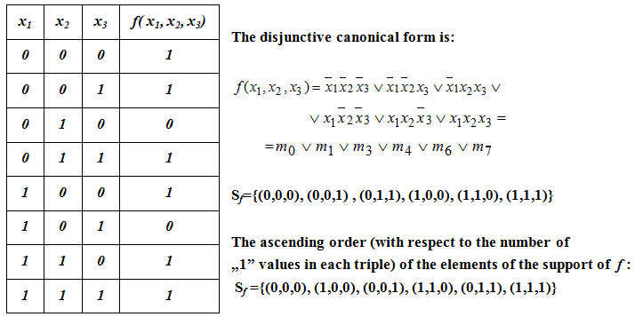
EXAMPLE 2. SIMPLIFY THE BOOLEAN FUNCTION

Slide 9
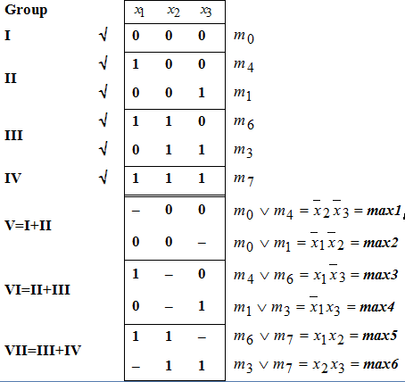
EXAMPLE 2 – FACTORIZATION PROCESS

Slide 10
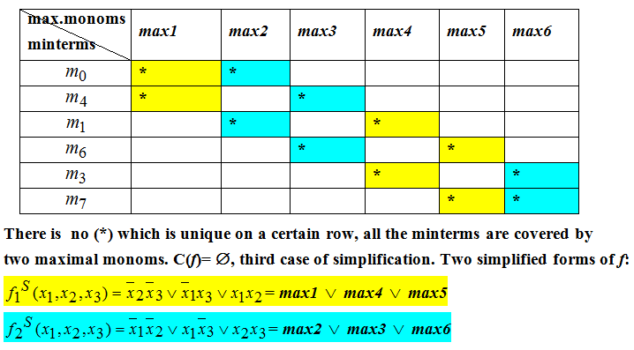
EXAMPLE 2 (CONTD.)

Slide 11
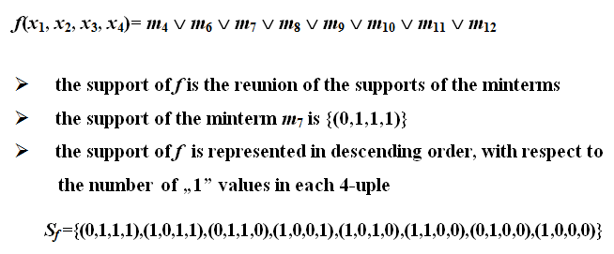
EXAMPLE 3. SIMPLIFY THE BOOLEAN FUNCTION

Slide 12
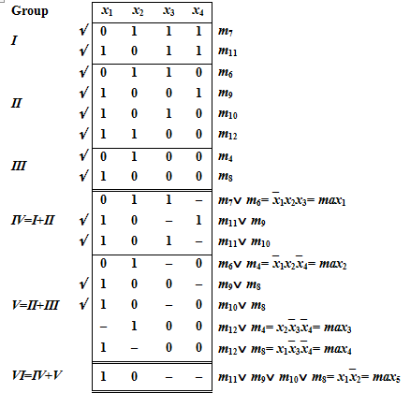
EXAMPLE 3 – FACTORIZATION PROCESS

Slide 13
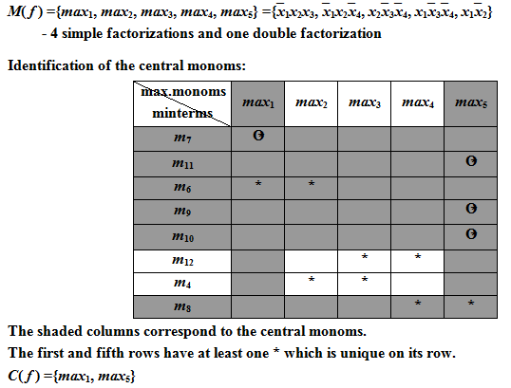
EXAMPLE 3 – CENTRAL MONOMS

Slide 14
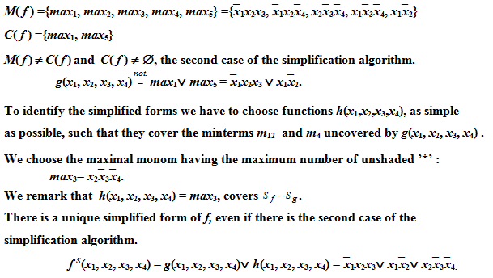
EXAMPLE 3 – SIMPLIFIED FORMS

Slide 15
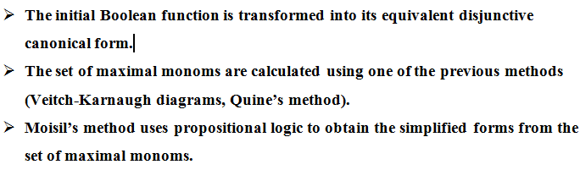
MOISIL’S SIMPLIFICATION METHOD

Slide 16
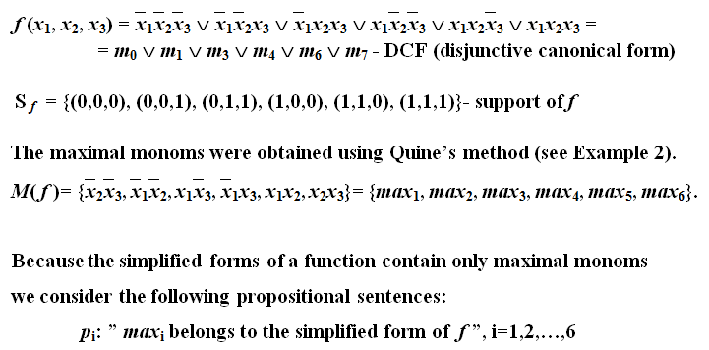
EXAMPLE 4. SIMPLIFY THE BOOLEAN FUNCTION

Slide 17

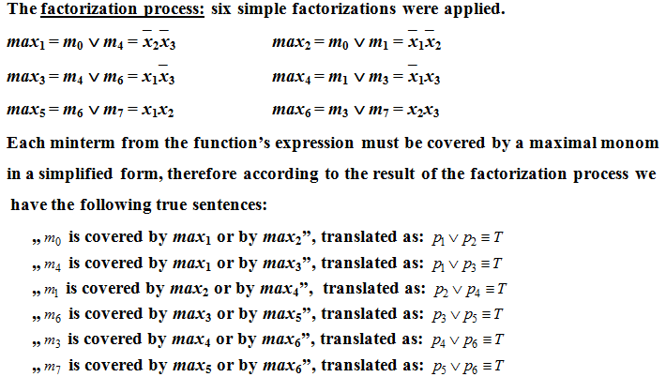
EXAMPLE 4 (CONTD.)

Slide 18
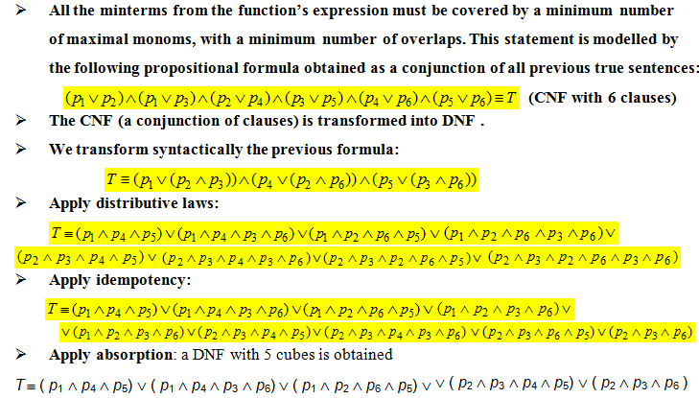
EXAMPLE 4 (CONTD.)

Slide 19
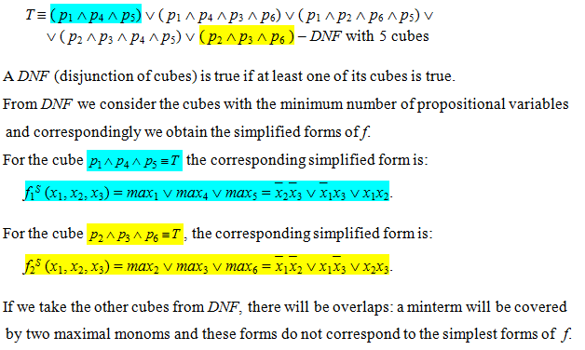
EXAMPLE 4 (CONTD.)

